Slide 1
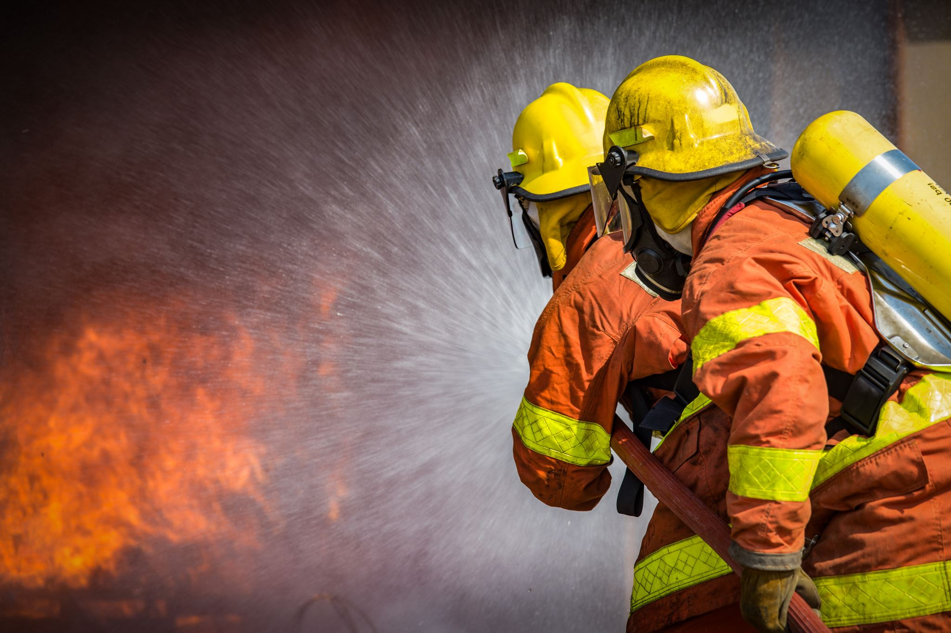
ESIP
Emergency Services Insurance Program
An insurance and risk management program built to meet the needs of emergency service organizations nationwide.

Slide 2

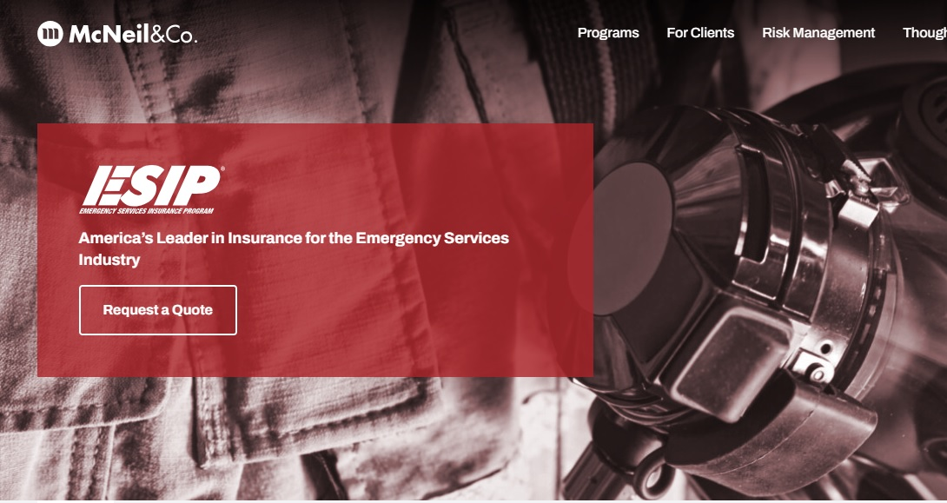
ESIP VOLUNTEER FIREFIGHTER ENHANCED CANCER INSURANCE TUTORIAL
Visit ESIP.com to and follow the link to start a quote or renew your policy.

Slide 3
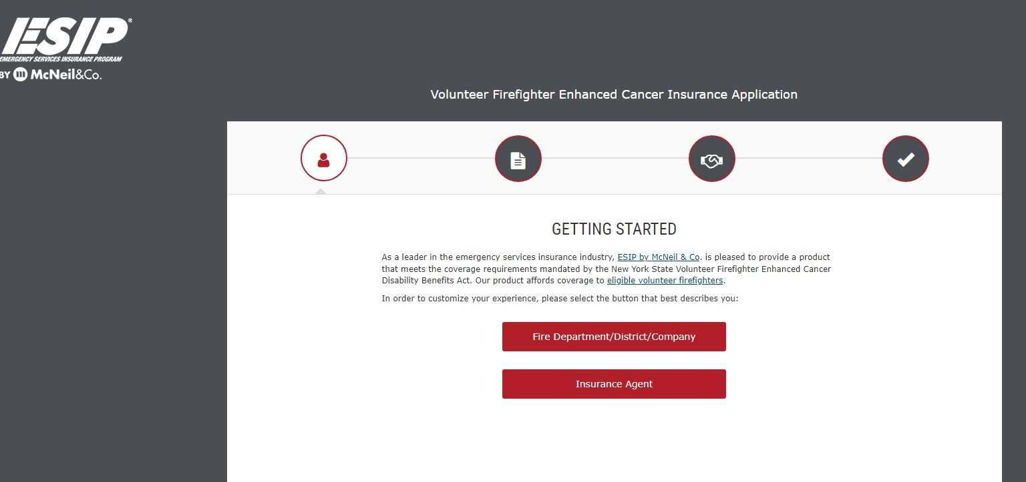
ESIP VOLUNTEER FIREFIGHTER ENHANCED CANCER INSURANCE TUTORIAL
Select Fire Department / District / Company option

Slide 4
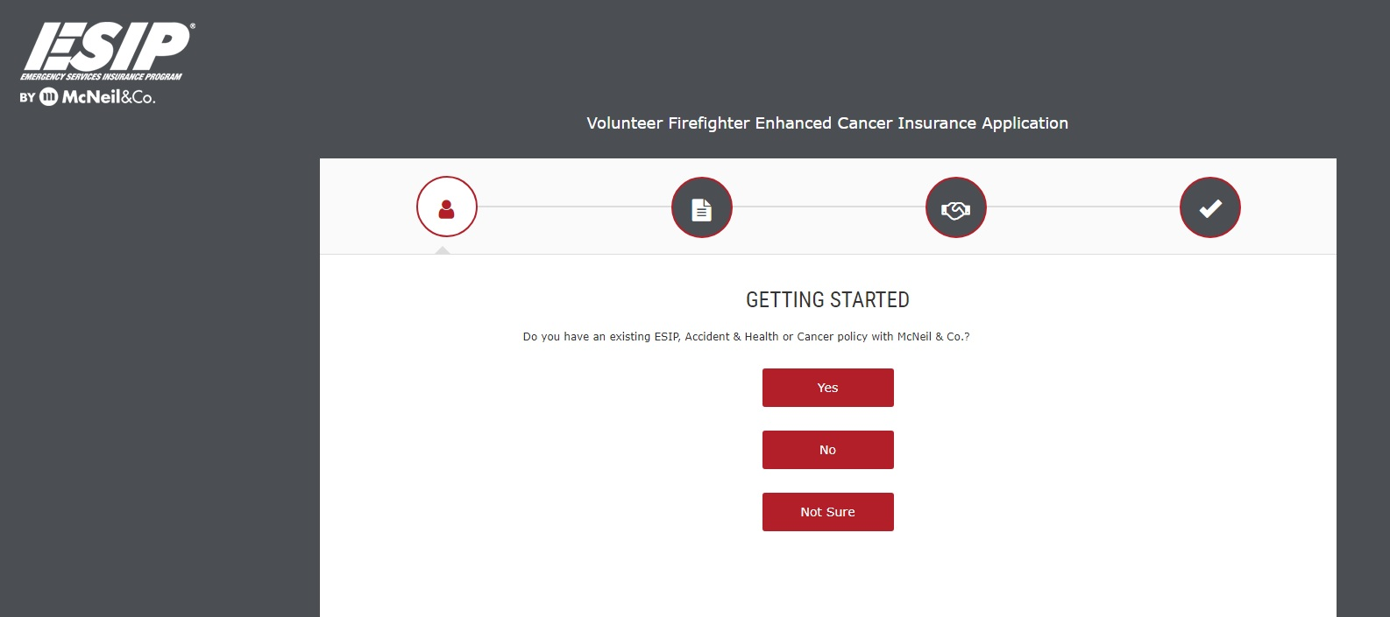
ESIP VOLUNTEER FIREFIGHTER ENHANCED CANCER INSURANCE TUTORIAL
Select appropriate option

Slide 5
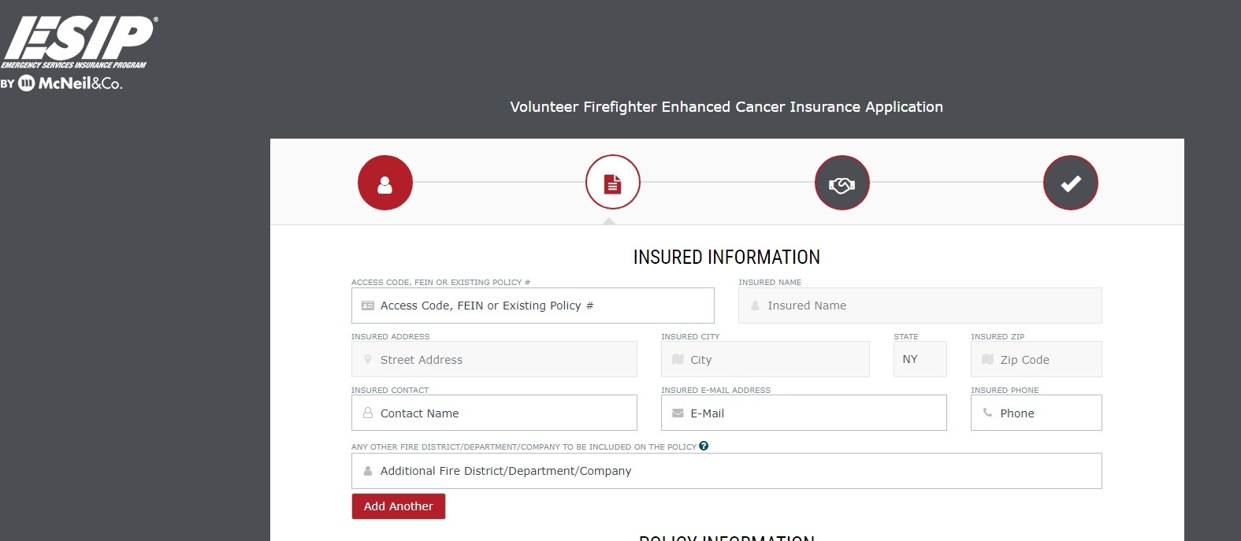
ESIP VOLUNTEER FIREFIGHTER ENHANCED CANCER INSURANCE TUTORIAL
Enter all applicable information. You may also correct or update any information that has pre-filled.
If you need additional information, simply click on the “?”
Need a Policy Number? Use the policy number located on your Auto ID Card in any of your fire department vehicles.

Slide 6
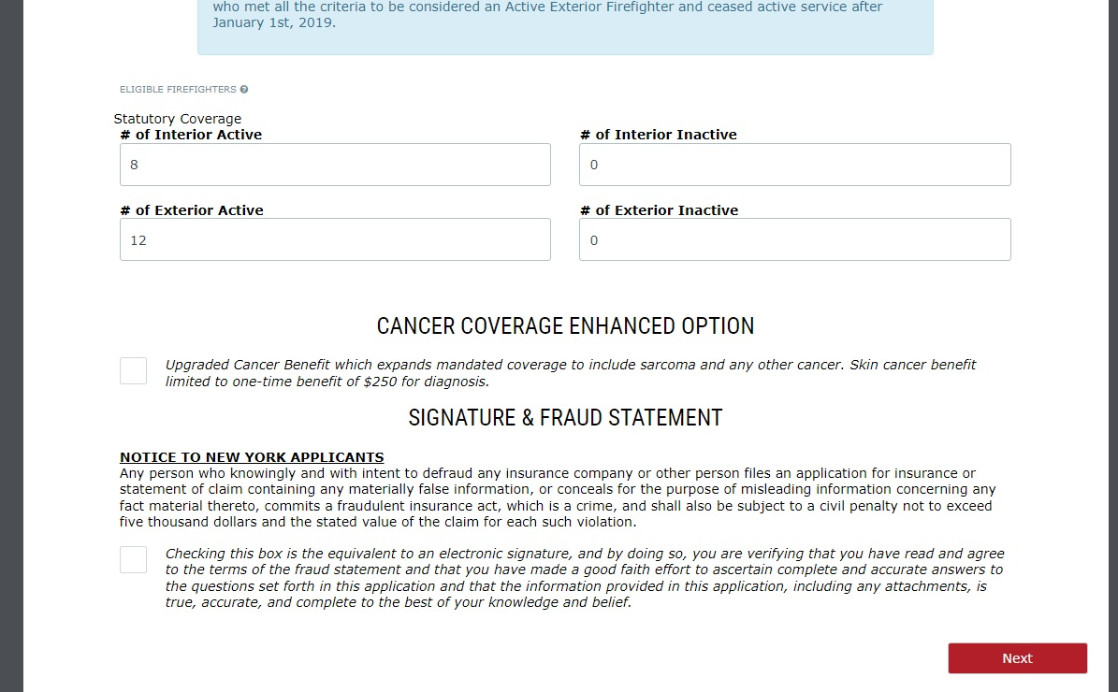
ESIP VOLUNTEER FIREFIGHTER ENHANCED CANCER INSURANCE TUTORIAL
Coverage required by law
Enter or Update the information listed.
Optional Exterior FF Coverage
Optional All-Cancer Coverage
If you need additional information, simply click on the “?”

Slide 7
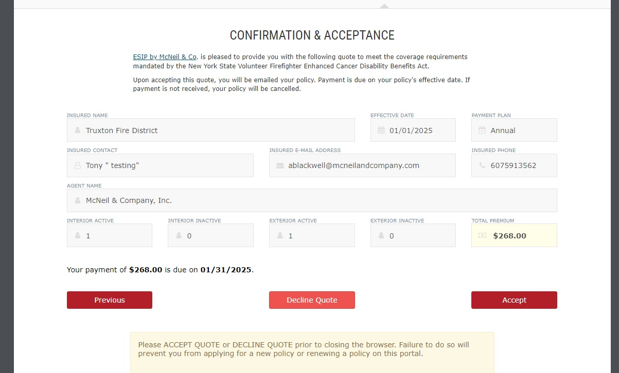
ESIP VOLUNTEER FIREFIGHTER ENHANCED CANCER INSURANCE TUTORIAL
Review your information before Accepting the quote.

Slide 8
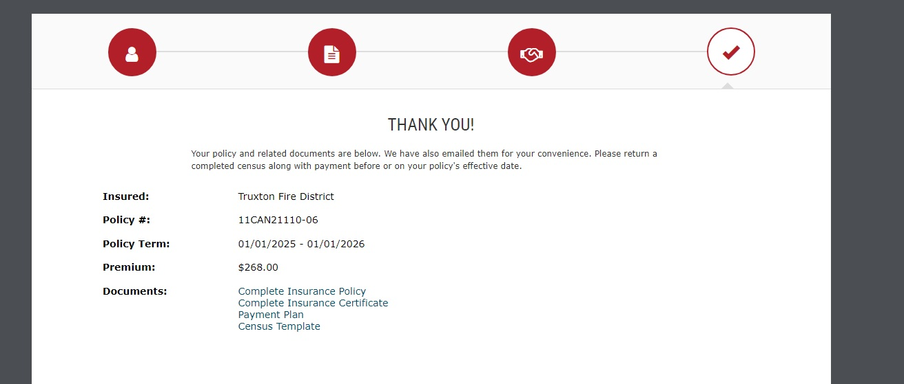
ESIP VOLUNTEER FIREFIGHTER ENHANCED CANCER INSURANCE TUTORIAL
Thank you for renewing your cancer policy with ESIP. You can download any of the Documents for your records.
We will issue your invoice by mail
Click to download

Slide 9
HAVE A QUESTION ?
Contact
Tony Blackwell, Territory Sales Manager
Toll Free: 800-822-3747 ext. 530
Direct Line: 607-428-1530
Cell: 607-591-3562
Email: ablackwell@mcneilandcompany.com

Slide 10

Risk Management- Training & Resources
Complimentary Services for every ESIP client
E-Learning
Online Training:
~Web-based platform, accessible 24/7, 365 days
~Webinar Recordings
~Tracking and Managing Tool for Officers/Managers
~Custom Courses specific to industry needs
~Document Dropbox
Assigned Safety Specialist:
Each state has a designated Program Safety Specialist to provide clients with direct assistance in areas of need, ranging from help navigating through the training platform to coordination of on-site training
Resources/Tools:
~Standard Operating Procedures sample forms
~On-site training upon request
~ Driver Training
~ Defensive Driving Courses
~ Safety Posters
~ MVRs

