Slide 1
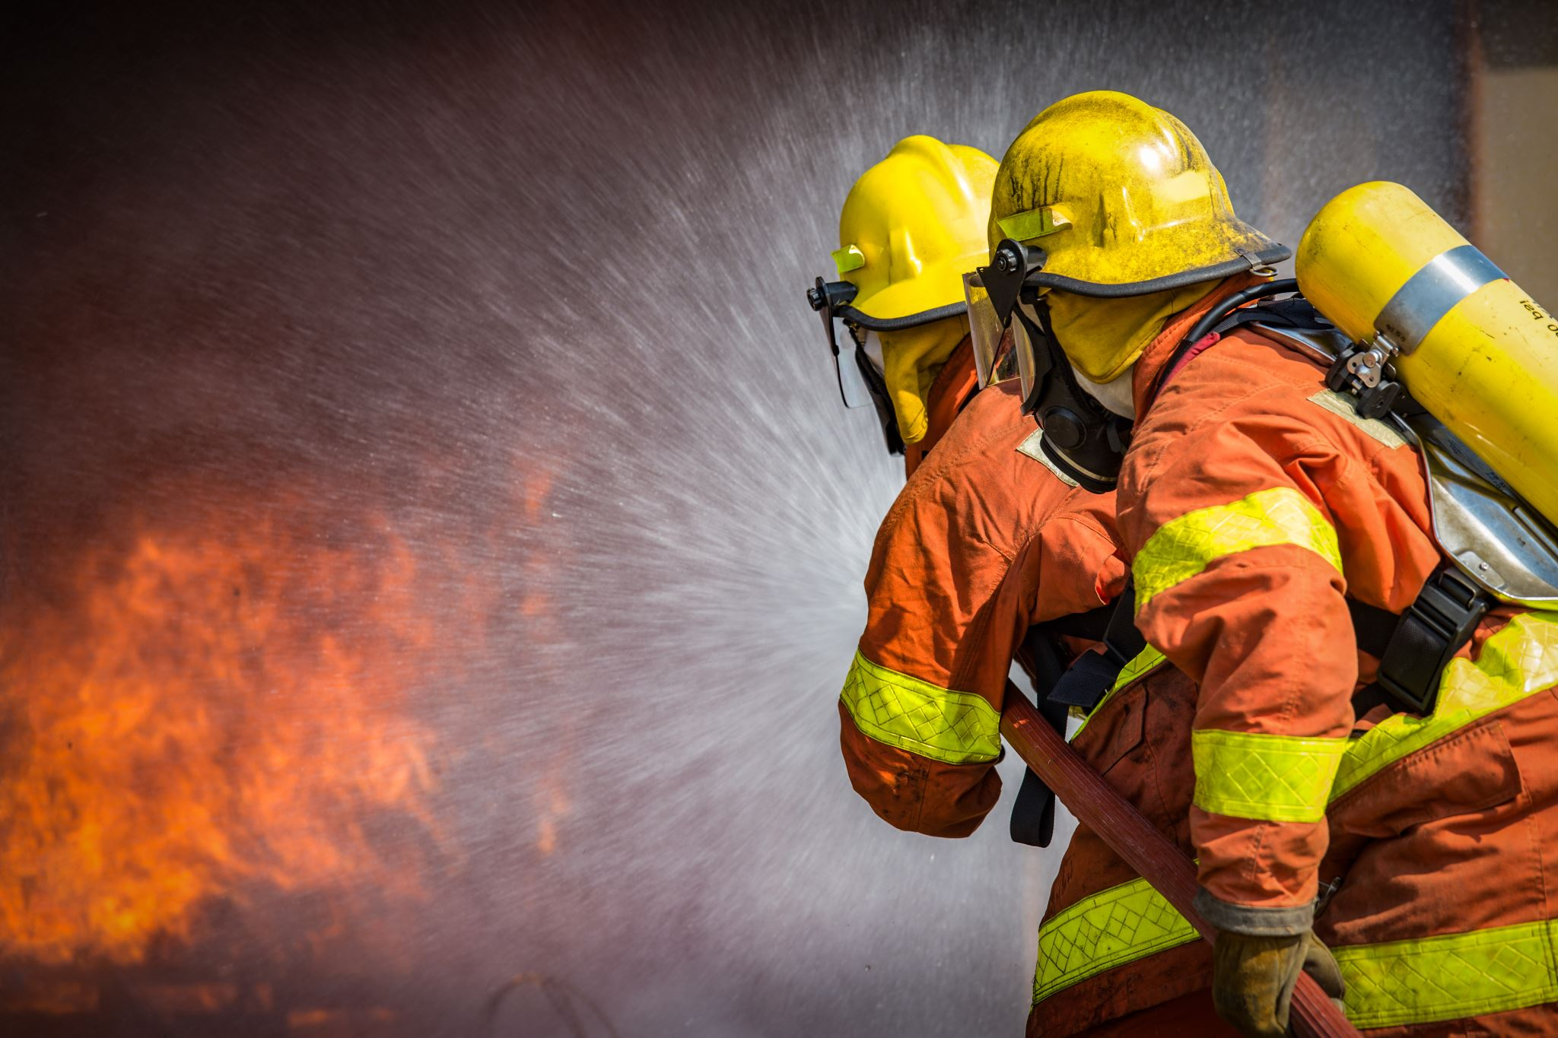
ESIP
Emergency Services Insurance Program
An insurance and risk management program built to meet the needs of emergency service organizations nationwide.

Slide 2
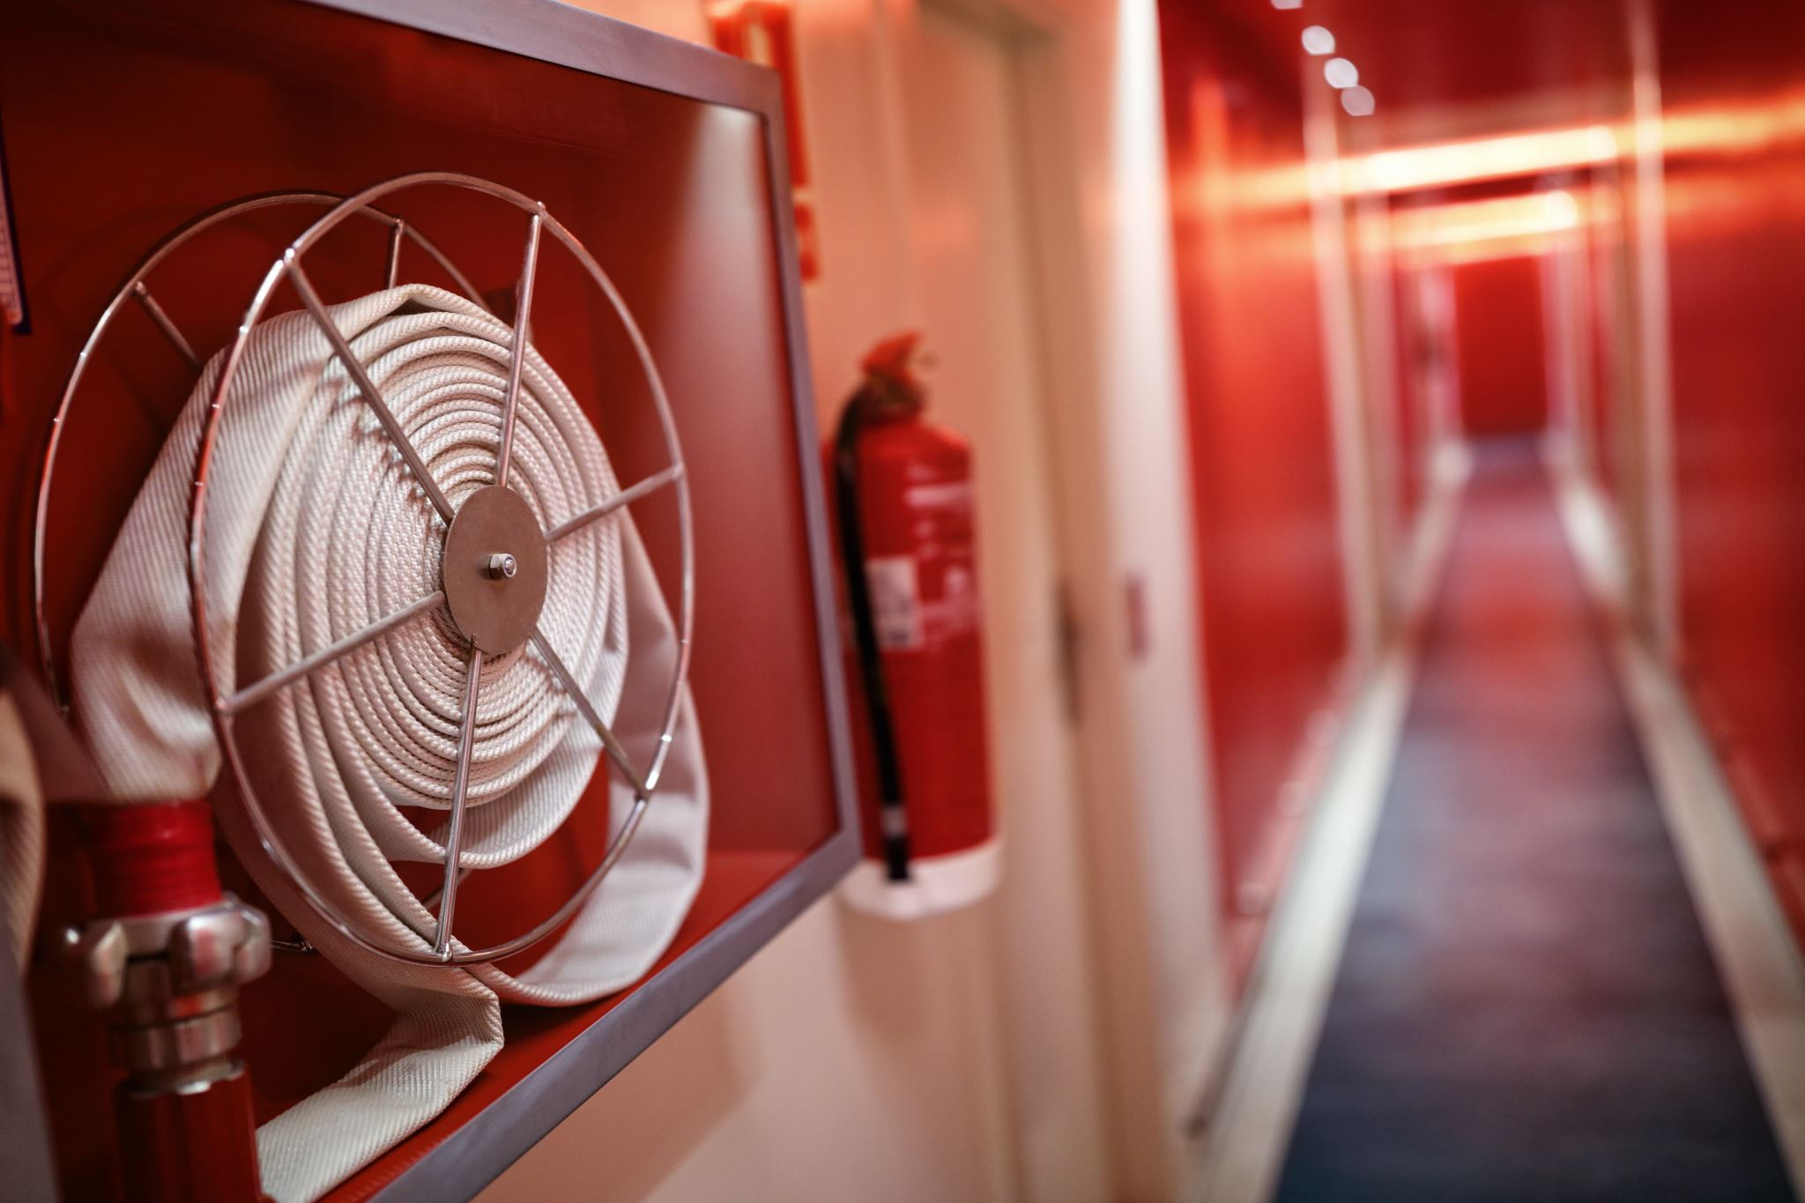
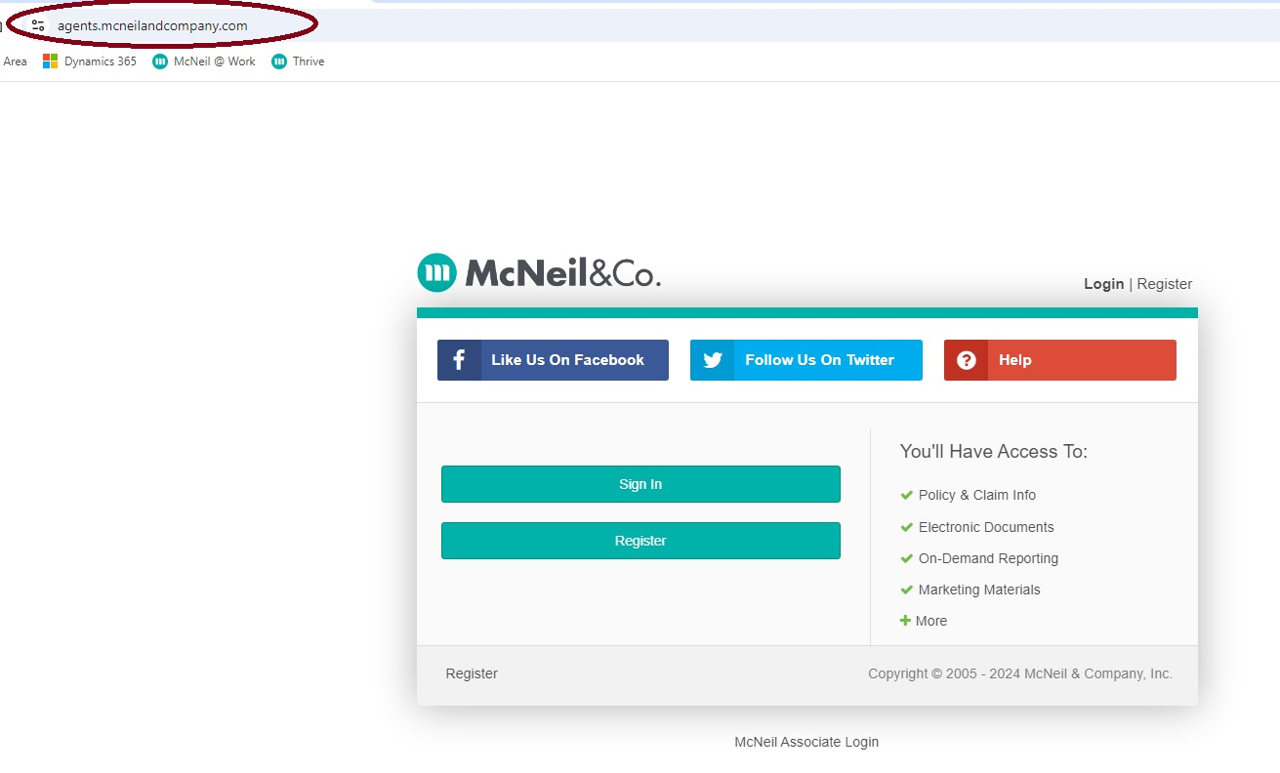
ESIP VOLUNTEER FIREFIGHTER ENHANCED CANCER INSURANCE TUTORIAL FOR OUR PARTNER BROKERS
Log into the McNeil & Co. Agent Area.
If you are not registered to access this area, please contact your Territory Sales Manager.
You can still renew your ESIP cancer policies or bind a new policy by going to www.esip.com and follow the link to the ESIP Cancer Portal.

Slide 3
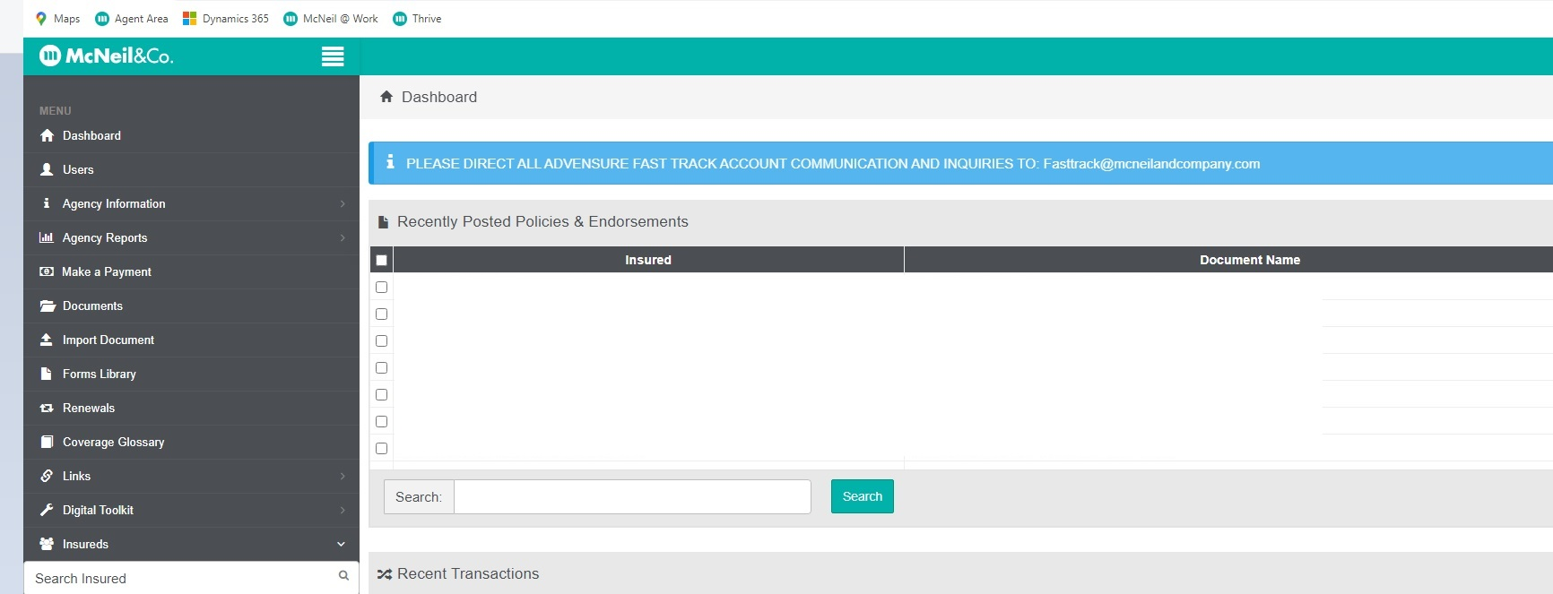
ESIP VOLUNTEER FIREFIGHTER ENHANCED CANCER INSURANCE TUTORIAL FOR OUR PARTNER BROKERS
If you access the cancer portal direct from the ESIP website, skip this slide.
Once in your Agent Area, select the Renewals link on the left side of your Dashboard.

Slide 4
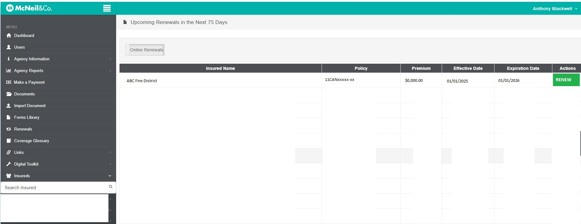
ESIP VOLUNTEER FIREFIGHTER ENHANCED CANCER INSURANCE TUTORIAL FOR OUR PARTNER BROKERS
If you access the cancer portal direct from the ESIP website, skip this slide.
Once you’ve selected the Renewals tab, select “Online Renewals and all your ESIP Cancer policy renewals will appear.
Select the Insured you wish to renew and click on the green tab.
This will take you directly to the ESIP Cancer Portal

Slide 5
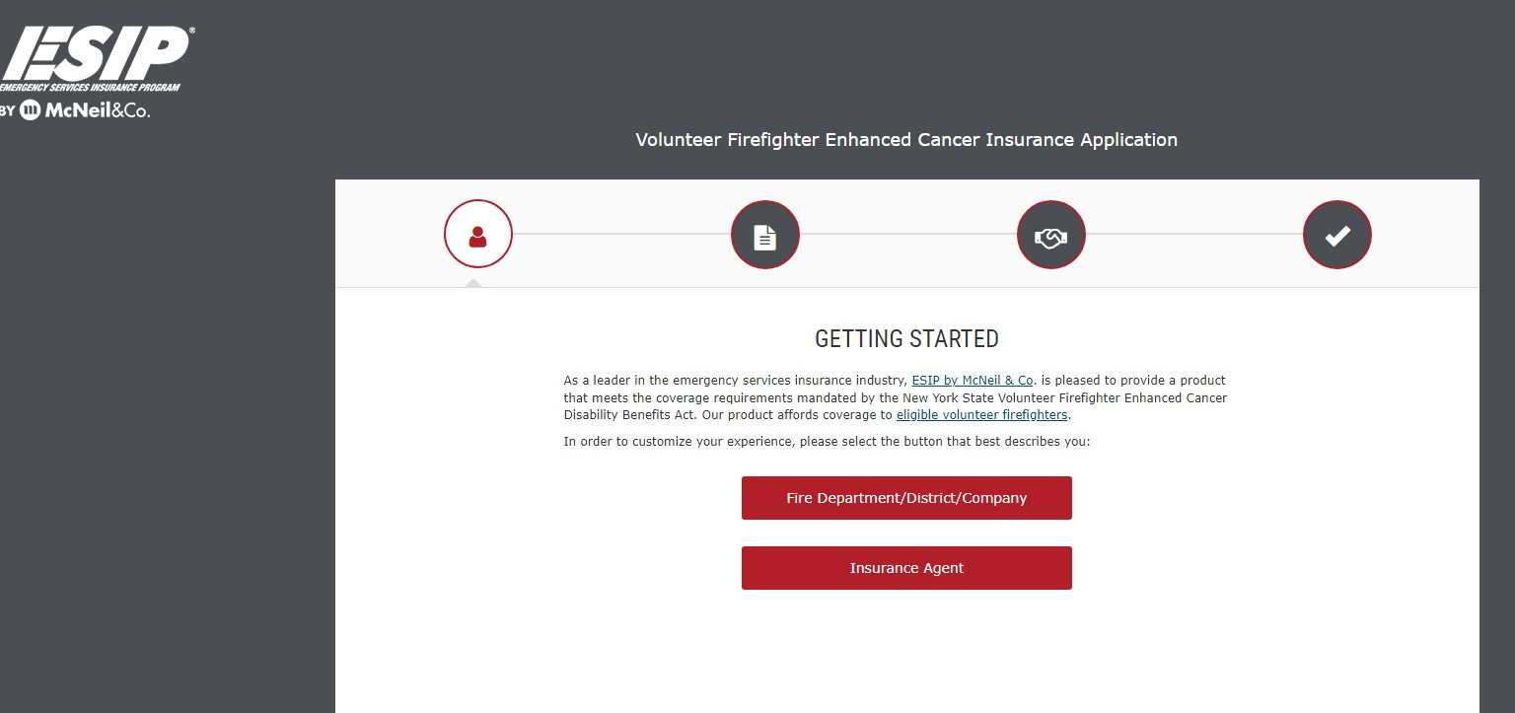
ESIP VOLUNTEER FIREFIGHTER ENHANCED CANCER INSURANCE TUTORIAL FOR OUR PARTNER BROKERS
NOTE: If you are not an appointed broker/agent for ESIP, you will not be able to continue.
Call 800-822-3747 ext. 138.

Slide 6
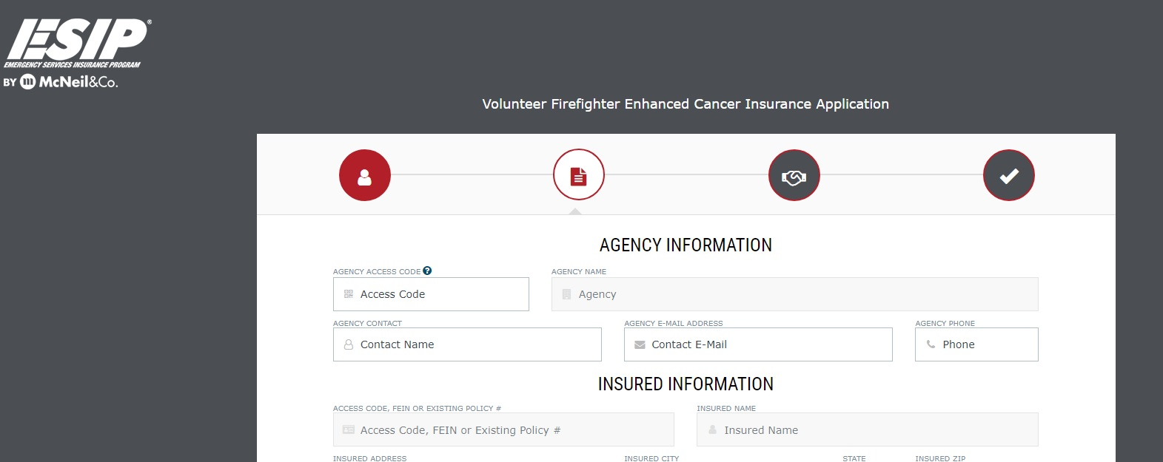
ESIP VOLUNTEER FIREFIGHTER ENHANCED CANCER INSURANCE TUTORIAL
You will need to fill in any information that has not automatically pre-filled .
Can’t find your Access Code? Contact your Territory Sales Manager or Tony Blackwell at 607-428-1530

Slide 7
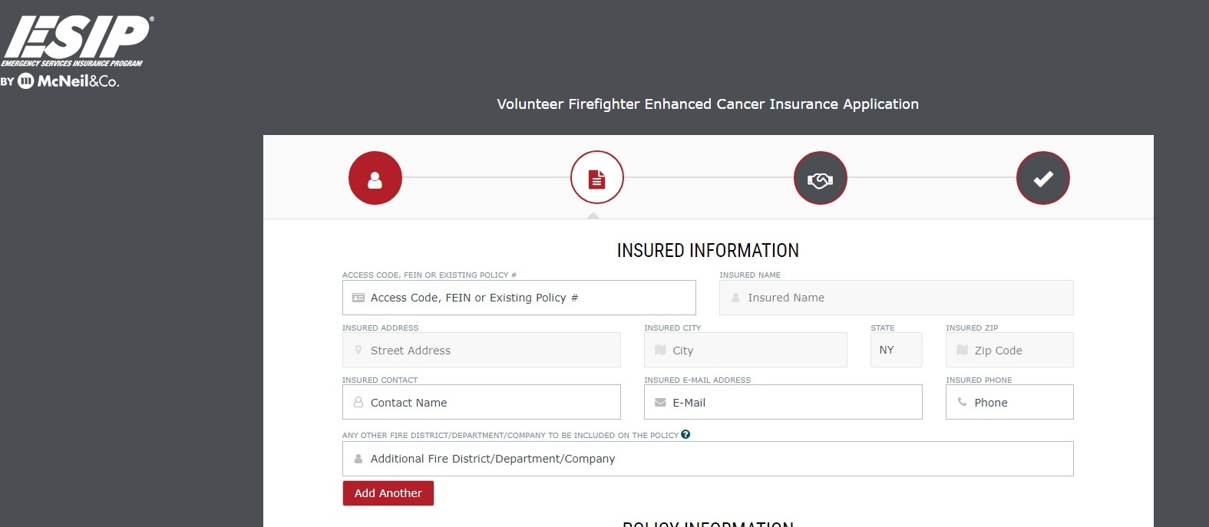
ESIP VOLUNTEER FIREFIGHTER ENHANCED CANCER INSURANCE TUTORIAL
You will need to fill in any information that has not automatically pre-filled .

Slide 8
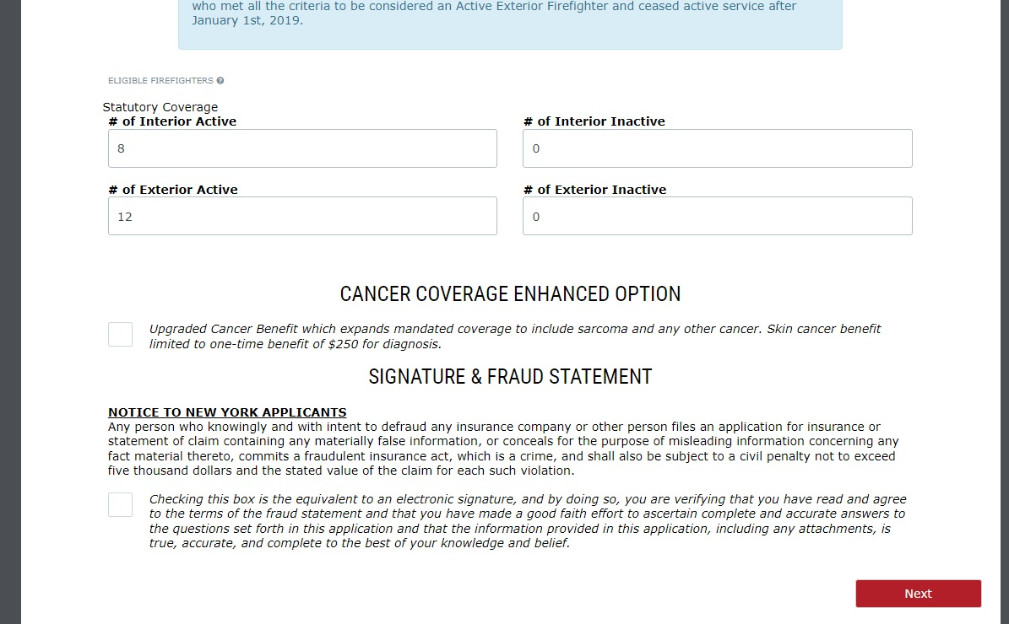
ESIP VOLUNTEER FIREFIGHTER ENHANCED CANCER INSURANCE TUTORIAL
Please fill in all applicable information and make any necessary change to the information pre-filled.
Coverage required by law
Optional Exterior FF Coverage
Optional All-Cancer Coverage
If you need additional information, simply click on the “?”

Slide 9
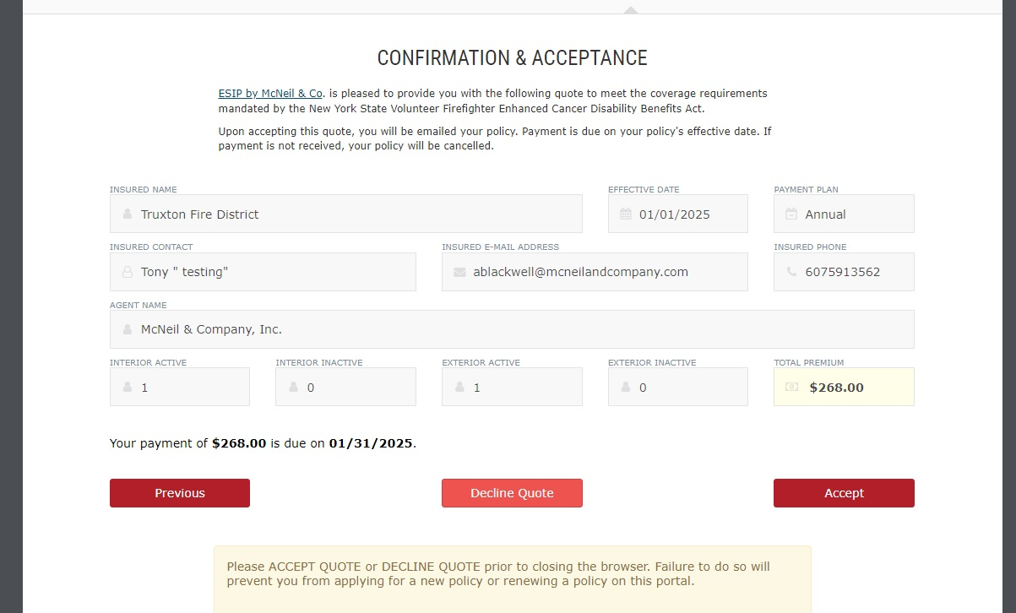
ESIP VOLUNTEER FIREFIGHTER ENHANCED CANCER INSURANCE TUTORIAL
Review your information before Accepting the quote.

Slide 10
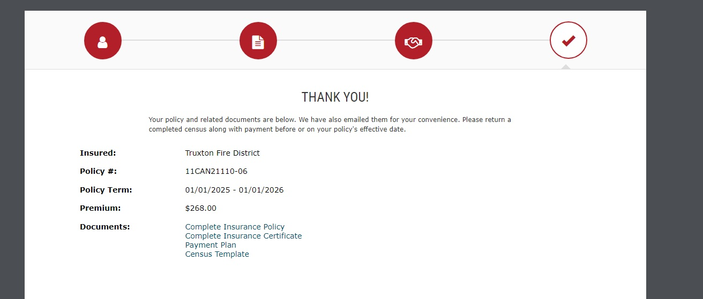
ESIP VOLUNTEER FIREFIGHTER ENHANCED CANCER INSURANCE TUTORIAL
Thank you for renewing your Insureds cancer policy with ESIP. You can download any of the Documents for your records.
We will issue the invoice by mail per your ESIP agreement.
Click to download

Slide 11

Risk Management- Training & Resources
Complimentary Services for every ESIP client
E-Learning
Online Training:
~Web-based platform, accessible 24/7, 365 days
~Webinar Recordings
~Tracking and Managing Tool for Officers/Managers
~Custom Courses specific to industry needs
~Document Dropbox
Assigned Safety Specialist:
Each state has a designated Program Safety Specialist to provide clients with direct assistance in areas of need, ranging from help navigating through the training platform to coordination of on-site training
Resources/Tools:
~Standard Operating Procedures sample forms
~On-site training upon request
~ Driver Training
~ Defensive Driving Courses
~ Safety Posters
~ MVRs

Slide 12
HAVE A QUESTION ?
Contact
Tony Blackwell, Territory Sales Manager
Toll Free: 800-822-3747 ext. 530
Direct Line: 607-428-1530
Cell: 607-591-3562
Email: ablackwell@mcneilandcompany.com
Contact your Territory Sales Manager and ask about our Specialty Programs available or visit us online at www.mcneilandcompany.com

